Slide 1
Midterm Report
Parson’s Programming Puzzles:
Optimizing Efficiency and Investigating
the Effects of Feedback
Further research on Social Addictive Gameful Engineering (SAGE) design
and computational thinking (CT)
Spring 2021
Alexander Liebeskind

Slide 2
Progress Summary
Setup/Initialization
Preprocessing
Analysis
Normality testing
Performance
Cognitive load
Interpretation
Notes:
Parson’s Programming Puzzles: A Fun and Effective Learning Tool for First Programming Courses
Established original Parson’s Programming Puzzles and key aims (maximize the engagement, constrain the logic, permit common errors, model good code, and provide immediate feedback)
Lessons Learned from Available Parsons Puzzles Software
Researched PPP implementations ( Hot Potatoes Implementation, JS-Parsons, Epplets, and EvoParsons) and determined ideal PPP constraints
Measuring Cognitive Load in Introductory CS: Adaptation of an Instrument
Established metrics for cognitive load and introduced cognitive load theory (working memory constraint)

Slide 3
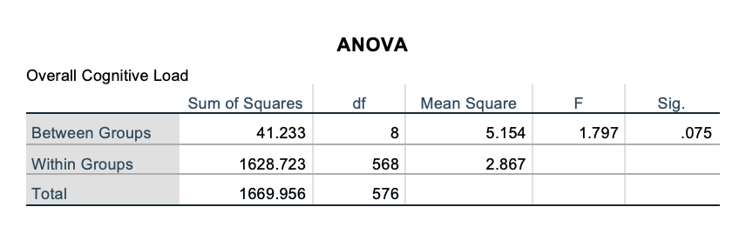
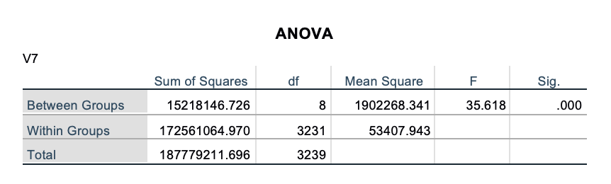
Preliminary Results
Cognitive Load
Performance (Training)
*V7 = performance column (labelled automatically in SPSS)
Notes:
Background:
Field study 1 (fs1) was recently completed, written up, and submitted for publication (Integrating Parsons Programming Puzzles with Scratch), which explored cognitive load, performance, efficiency, and motivation across PPP conditions
These findings support the hypothesis that (1) PPP and PPP with distractors training increases motivation and
reduce extraneous cognitive load (as compared to limited constraint and feedback), but refute the hypothesis (2) PPP training yields the highest learning efficiency.
Research Aims:
Extend upon prior investigation of Social Addictive Gameful Engineering (SAGE) and computational thinking (CT) by completing field study 2 (fs2)
Field study 2 (fs2) is underway - data collection has just been completed
Preprocessing, analysis, and write-up have not yet begun
Stretch goal: fs3 design and execution

Slide 4
Discussion
Data completeness
Training data vs. transfer data
Binary vs. non-binary performance scoring
Puzzle scoring
fs1 feedback
Methodology updates (e.g. quantitative motivation analysis, etc.)
Notes:
1. fs1 GDI Paper
Read referenced papers and define key terms to inform fs2 analysis approach
2. Relevant Statistics and Graphical Methods
Explore prior methodology in relevant studies
3. Data Extraction
Qualtrics results have been exported, stored, and validated for MTurk/Prolific approvals
Remaining Qualtrics work is to categorize participants by condition
Access SAGE database for quantitative findings
4. Data Timing and Correctness Preprocessing
Pre and post test data must be found across conditions to determine if there are any significant differences between groups
5. Analysis
Use SAGE data (time per puzzle per student, correctness of final submission, number of moves, explanation upon submission, and move visualizations) to compute usage data, cognitive load, efficiency, performance, and motivation and inter-condition differences
6. Writing, Editing, and Submission
Paper write-up and iterative editing cycles
7. Stretch Goals
Protocol content for looping CT concept, games across conditions, game instructions, Qualtrics study guide, etc.

Slide 5
Ongoing Objectives
1. Finalize cognitive load and performance analysis
2. Efficiency (performance and instructional)
3. Motivation
4. Writing
Notes:
1. fs1 GDI Paper
Read referenced papers and define key terms to inform fs2 analysis approach
2. Relevant Statistics and Graphical Methods
Explore prior methodology in relevant studies
3. Data Extraction
Qualtrics results have been exported, stored, and validated for MTurk/Prolific approvals
Remaining Qualtrics work is to categorize participants by condition
Access SAGE database for quantitative findings
4. Data Timing and Correctness Preprocessing
Pre and post test data must be found across conditions to determine if there are any significant differences between groups
5. Analysis
Use SAGE data (time per puzzle per student, correctness of final submission, number of moves, explanation upon submission, and move visualizations) to compute usage data, cognitive load, efficiency, performance, and motivation and inter-condition differences
6. Writing, Editing, and Submission
Paper write-up and iterative editing cycles
7. Stretch Goals
Protocol content for looping CT concept, games across conditions, game instructions, Qualtrics study guide, etc.

Slide 6
Additional Resources
https://statistics.laerd.com/spss-tutorials/one-way-anova-using-spss-statistics-2.php
https://statistics.laerd.com/spss-tutorials/testing-for-normality-using-spss-statistics.php
https://statistics.laerd.com/spss-tutorials/kruskal-wallis-h-test-using-spss-statistics.php
Notes:
1. fs1 GDI Paper
Read referenced papers and define key terms to inform fs2 analysis approach
2. Relevant Statistics and Graphical Methods
Explore prior methodology in relevant studies
3. Data Extraction
Qualtrics results have been exported, stored, and validated for MTurk/Prolific approvals
Remaining Qualtrics work is to categorize participants by condition
Access SAGE database for quantitative findings
4. Data Timing and Correctness Preprocessing
Pre and post test data must be found across conditions to determine if there are any significant differences between groups
5. Analysis
Use SAGE data (time per puzzle per student, correctness of final submission, number of moves, explanation upon submission, and move visualizations) to compute usage data, cognitive load, efficiency, performance, and motivation and inter-condition differences
6. Writing, Editing, and Submission
Paper write-up and iterative editing cycles
7. Stretch Goals
Protocol content for looping CT concept, games across conditions, game instructions, Qualtrics study guide, etc.

